Slide 1
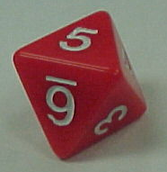
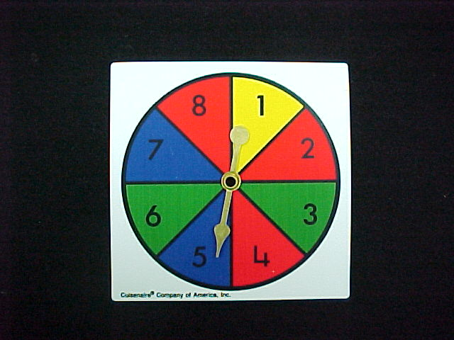
Artificial Intelligence
Probability

Slide 2
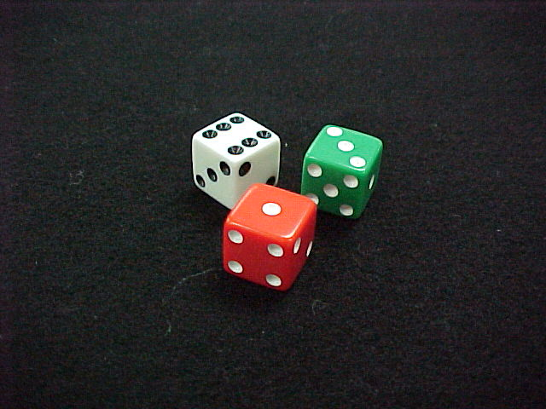
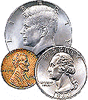
What are the Chances?
A probability experiment is something that can happen in more than one way.

Slide 3
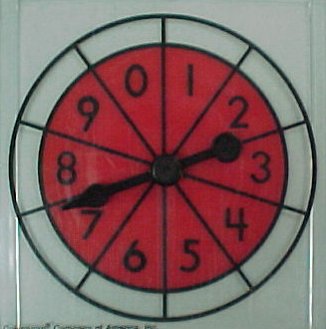
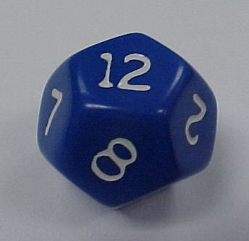
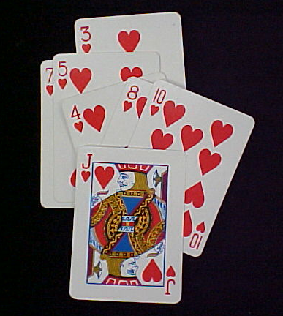
The outcomes of an experiment are the ways it can happen.
6
10
12
52
The event is the particular outcome you are looking for.

Slide 4
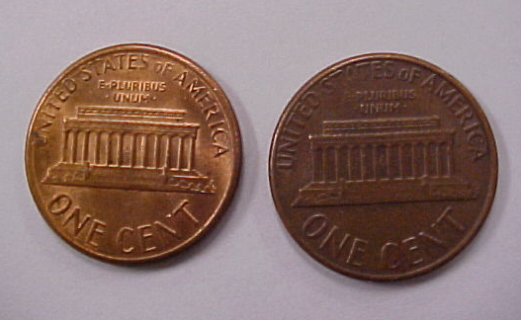
The Probability of an Event =
P(Event) = the number of ways it can happen
the number of possible outcomes
P(H+T) = 2 = 1
__ __
4 2
H H
T T
H T
T H

Slide 5
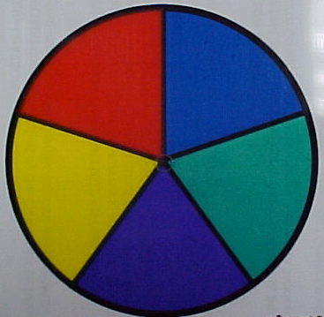
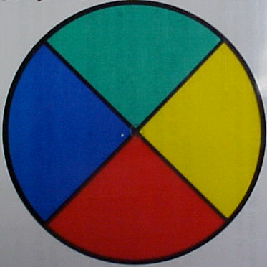
Try these…
a)
b)
P(red)
P(blue)
P(yellow or blue)
1
5
2
5
3
5
A
A
A
B
B
B
1
4
1
4
1
2

Slide 6
Prior probability:
Probability in the absence of any other information
Concepts:
P(Dice = 2) = 1/6
Random variable: Dice
Domain = <1, 2, 3, 4, 5, 6>
Probability distribution:
P(Dice) = <1/6, 1/6, 1/6, 1/6, 1/6, 1/6>

Slide 7
Conditional Probability
Conditional Probability contains a condition that may limit the sample space for an event.
You can write a conditional probability using the notation
- This reads “the probability of event B, given event A”

Slide 8
Conditional Probability
The table shows the results of a class survey.
Find P(own a pet | female)
Do you own a pet?
yes no
female 8 6
male 5 7
14 females;
13 males
The condition female limits the sample space to 14 possible outcomes.
Of the 14 females, 8 own a pet.
Therefore, P(own a pet | female) equals
8
14

Slide 9
Conditional Probability
The table shows the results of a class survey.
Find P(wash the dishes | male)
Did you wash the dishes last night?
yes no
Female 7 6
male 7 8
13 females;
15 males
The condition male limits the sample space to 15 possible outcomes.
Of the 15 males, 7 did the dishes.
Therefore, P(wash the dishes | male)
7
15

Slide 10
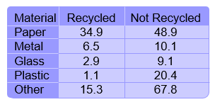
Let’s Try One
Using the data in the table, find the probability that a sample of not recycled waste was plastic. P(plastic | non-recycled)
The given condition limits the
sample space to non-recycled
waste.
A favorable outcome is
non-recycled plastic.
P(plastic | non-recycled) =
20.4
48.9 + 10.1 + 9.1 + 20.4 + 67.8
=
20.4
156.3
0.13
The probability that the non-recycled waste was plastic is about 13%.

Slide 11
Conditional Probability Formula
For any two events A and B from a sample space with P(A) does not equal zero

Slide 12



Conditional Probability
Researchers asked people who exercise regularly whether they jog or walk. Fifty-eight percent of the respondents were male. Twenty percent of all respondents were males who said they jog. Find the probability that a male respondent jogs.
0.2
0.58
= Substitute 0.2 for P(A and B) and 0.58 for P(A).
0.344 Simplify.
The probability that a male respondent jogs is about 34%.

Slide 13
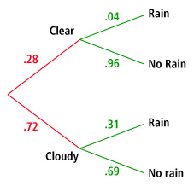
Using Tree Diagrams
Amir created the tree diagram after examining years of weather observations in his hometown. The diagram shows the probability of whether a day will begin clear or cloudy, and then the probability of rain on days that begin clear and cloudy.
Find the probability that a day will start out
clear, and then will rain.
The path containing clear and rain represents days that start out clear
and then will rain.
P(clear and rain) = P(rain | clear) • P(clear)
= 0.04 • 0.28
= 0.011
The probability that a day will start out clear and then rain is about 1%.

Slide 14
(continued)
Find the probability that it will not rain
on any given day.
The paths containing clear and no rain and cloudy and no rain both represent a day when it will not rain. Find the probability for both paths and add them.
P(clear and no rain) + P(cloudy and no rain) =
P(clear) • P(no rain | clear) + P(cloudy) • P(no rain | cloudy)
= 0.28(.96) + .72(.69)
= 0.7656
The probability that it will not rain on any given day is about 77%.

Slide 15
E.g. The probability that a married man watches a certain TV show = 0.4
The probability that a married woman watches the show = 0.5.
The probability that a man watches the show given that his wife does=0.7
Find the probability that
(i) A married couple both watch the show
(ii) A wife watches if her husband does
(iii) At least one person of a married couple watches the show
Answer
Let H = {husband watches show} W = {wife watches show}
(i)
(ii)
(iii)
= 0.4 + 0.5 – 0.35
= 0.55

Slide 16

Joint Distribution
The joint probability distribution for a set of random variables, X₁,…,X_{n} gives the probability of every combination of values (an n-dimensional array with v^{n} values if all variables are discrete with v values, all v^{n} values must sum to 1): P(X₁,…,X_{n})

Slide 17
Joint Distribution
The probability of all possible conjunctions (assignments of values to some subset of variables) can be calculated by summing the appropriate subset of values from the joint distribution
?

Slide 18
Joint Distribution
?

Slide 19
Joint Distribution
Therefore, all conditional probabilities can also be calculated.

Slide 20
Conditional independence

Slide 21
Absolute independence

